Slide 1
        Maintenance of Judicial Record
By: Zia-ur-Rehman
District & Sessions Judge,
Mansehra
---------------------------------

Slide 2
Management:
The skill or practice of controlling, directing, or planning, especially a business, institution.
Court management; comprised of
  Self-management. (attitude, knowledge of law & facts, passion, code of conduct)
  Time-management. (attendance, classification of cases)
  Stress-management. (to avoid, do plan)
  Case flow management. (prioritization)
  Maintenance of record
  Correspondence
---------------------------------

Slide 3
RESPONSIBILITIES OF A JUDGE
Every Judicial Officer is responsible for:
Supervision of his establishment, court work
Due observance of law and the orders
Work of attached ministerial staff
Proper maintenance of the Files, Registers and Accounts
Correspondence through official channel
All pecuniary transactions, to be conducted in presence of a judicial officer
Valuation of suits and Court Fee
Timely and correct consignment of Record
Assets of the Court, furniture, library, equipment's etc.
Time Bound disposal of case and delay
Implementation of Code of Conduct
-----------------------------------

Slide 4
Court Work, Division
Judicial
Administrative
(a) Judicial
Registration Process
Diary Management
Scrutiny & admission mechanism (Prima facie, Valuation, Limitation, Court Fee, Legal Bar etc)
Process & attendance (publication)
Defense version (written statement, rejoinder, cross objection)
Miscellaneous application (injunctions, amendment)
Issues & list of witnesses
Evidence, Rules of caution (Penal provision, ousting co-oral witness, authenticity of documents, STOs, documents, dictation)
Hearing Arguments (notes, case law, prior study)
Judgment (issue wise, reasoning, appreciation, law, decree sheet)
Decree sheet
Consignment
(b) Administrative
Registers
Library5
Correspondence Record
Meeting minutes
Confessions
Deposits
Fines
Inspection Notes
Fortnightly & monthly reports
Cause Lists
Assets, Equipment & Accessories

Slide 5
WHY NEED INTEGRATED APPROACHED TO RECORD MANAGEMENT?
Lack of uniform classification and filing system.
Lack of systematic and orderly transfer of inactive records.
Lack of standardization and control to the creation of record.
Loss or misfiling of records.
Lack of storage space and filing equipment.
---------------------

Slide 6
MAINTENANCE OF RECORD
Definitions
Record:
Information captured in reproducible form required for conducting any transaction or activity.
Maintenance:
A logical and practical approach towards creation, keeping, use and disposition of records.
-----------------

Slide 7
OBJECT:
Maintenance of true, correct and proper record of Judicial Proceedings is essential for safe administration of justice and for safeguarding valuable rights of citizens.
Application of judicial mind can only be ensured when
diligently prepared correct record is easily
-------------------------

Slide 8
GOALS
Create only necessary for efficient and successful operation of the system.
Timely production of the record when needed.
Retain/preserve only records needed for continued operation of the institution and dispose what is not needed.
--------------------------

Slide 9
Life Cycle Concept
Record pass through three main staged from its creation and active use to its final disposition.
Basic Categories:
Active
Inactive
Dead
-------------------------------

Slide 10
Instructions about Size and Quality of Paper
High Court Rules &
Orders Volume-IV Ch:16
All copies of judicial documents, all applications and petitions should be written on the standard pattern water marked petition paper.
Paper to be kept flat at its full size (13 ½ X 8 ½)
Foolscap paper, should be used for all English portion of the record and to be kept flat
‘B’ Quality paper to be used for process
Economy to be exercised in use of paper
Registers to be obtained from Official Printing Press
Uniform size of paper for Records

Slide 11
Advantages of Uniform size of Records
Facilitation in compilation
Space saving in Record Room by making the files into compact and even block.
Protection from injury from constant use and while in transit, as papers of one size are less easily frayed at the edges by being tied out, untied, and are less liable to be get folded, torn and damaged in general use.
____________________________________

Slide 12
Instructions to Prevent Waste
Except in warrant cases and Civil Suit, depositions of witnesses be written continuously instead of separate sheets.
A clear space of 2/3 inches be left blank between the end of one statement and the beginning of the next.
The practice of writing orders and other matters across the top and along with the sides of a page should be discontinued.
Reasonable margin should be left on each side of the paper, so that writing may not be obliterated by fraying at the edges.
Files in use in court should be placed between stiff wooden or cardboard protectors of the size of the standard file, so that the strain of the cloth or covering, or of the string or tape, does not fall in the papers within.
Each file be tied with broad tape or nawar instead of string.
Each bundle of files should, until packed away in the Record Room, be kept between stiff covers to prevent fraying, folding etc.
English record and papers be placed at their full size in envelops of the size of file.
Exhibits should be folded to as nearly as possible the same size and placed in envelops of the size of the file.
----------------------

Slide 13

REGISTERS
High Court Rules &
Orders Volume-IV Ch:24
High Court Rules and Orders of 1902 and Standing Orders of the Judicial Commissioner, NWFP (KPK) 1937 direct Courts to maintain (printed) registers for different purposes.
-------------------

Slide 14
Important Registers to be maintained by Moharrir of a Civil Judge
Civil Suits No. - I
Divorce and Matrimonial cases, No. - III
Register of Probate, LOA and Succession, No. - V (Where empowered)
Miscellaneous, No. - VI
Pauper, all Civil Courts, - VII
Review, all Civil Court, - XII
Register of Imprisoned JD, all courts, - XVI
Relating to Property of Minors, - XXVI (if empowered)
Transferred Decree, all courts. - XXXIII
Execution Moharrir
Execution of Decrees, - X
Miscellaneous Petitions in Execution, - XI

Slide 15
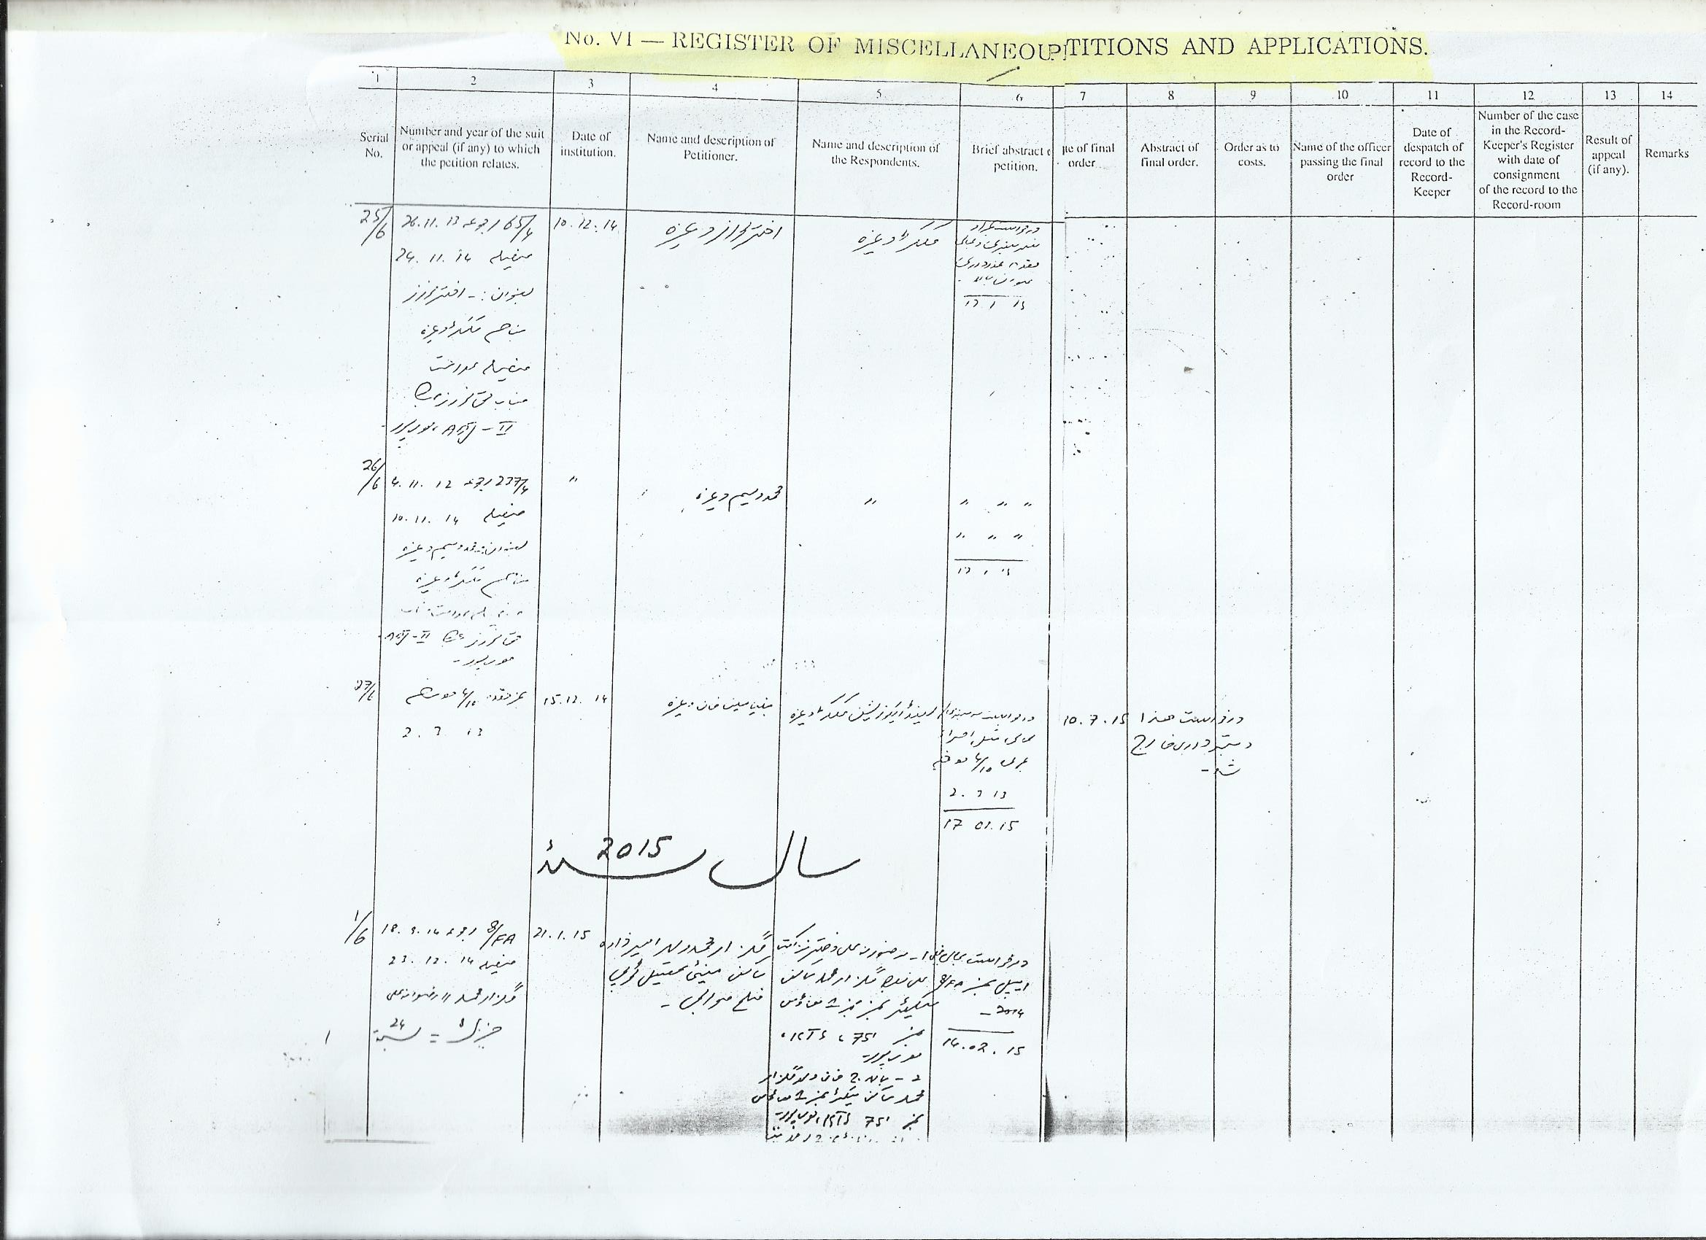

Slide 16
To be maintained by Reader
Rejected and Returned Plaints and Appeals. - VIII
Register of Dates. - IX
Persons Punished for contempt of Court. - XVII
Stamp Deficiencies. - XVIII
Commissions. - XIX
Register of Returned Documents. - XXIV
Deposit and Refund of Commission on sale proceeds in execution - XXV
-------------------------------

Slide 17
List of Criminal Registers
To be maintained by Moharrir of Judicial Magistrate
Register of complaint, cognizable and non-cognizable offences - I
PPC offences. - II
Special and Local Laws. - III
Miscellaneous - IV
Decided Cases. - V
Register of under trial Prisoners. - XII
Register of Fines. - XIV
Realized Fines. - XV
Prisoners Released, or of reduced punishment. - XIX
Traffic cases. - XXI
To be maintained by Reader
Register of Dates. - XI
Summary Trials. - XVII
Diet money of witnesses. - XVIII
-------------------------------

Slide 18
Miscellaneous Registers
General orders issued for guidance, with date of issuance. - E (Reader)
Miscellaneous Proceedings received from other Courts. - C (Moharrir)
Dispatch. - D (Moharrir)
Affidavits. - I (Reader)
Register Dak. - K DSJ → English Clerk
SCJ → Civil Nazir
Register of General Correspondence, - I English Clerk
Register of Ministerial Staff, - G DSJ → English Clerk
SCJ → Clerk of Court
Register of Petition Writers, - H DSJ → English Clerk
-------------------------------

Slide 19
Registers to be maintained by Record Keeper
General Register of Suits and Appeals disposed of (Civil) - XV
Returned Documents. - XXIV
General Register of Decided cases (Criminal) - XVI
Register of Files taken from the Record Room, - B
(Miscellaneous)

Slide 20
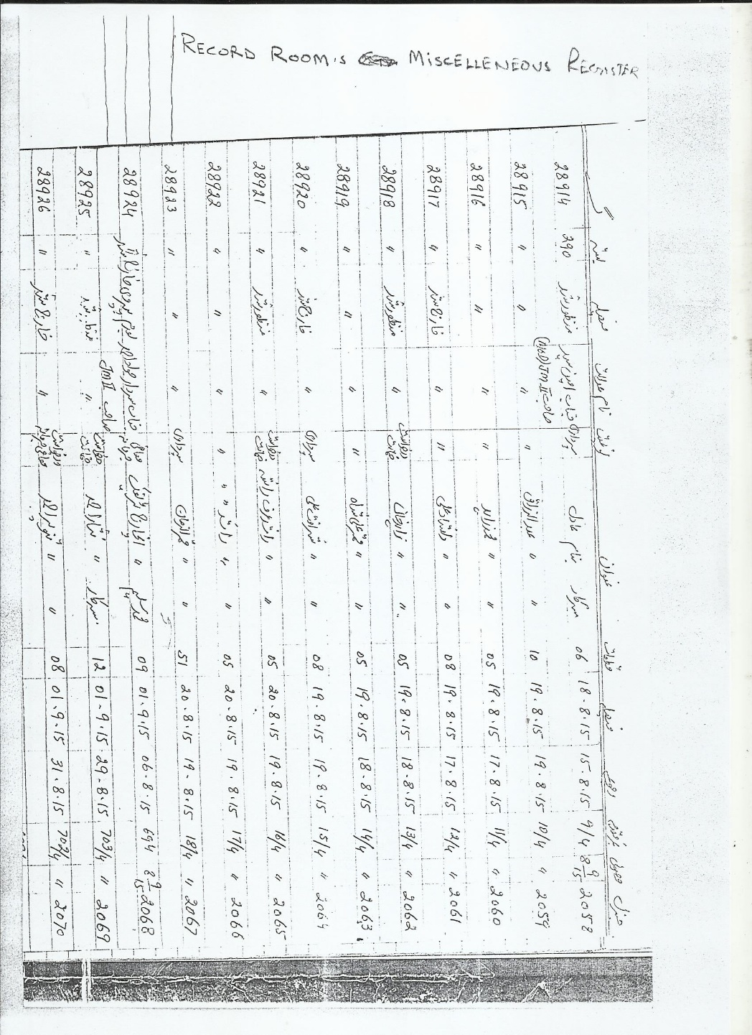

Slide 21
RECORDING
Preparation and compilation for consignment
Arrangement of Files A and B with separate index
General Index to remain on File A, containing particulars of contents of File B
Consignment in two files.
Folded papers be straitened, repaired.
Papers to be numbered, each sheet of a paper consisting upon more than one sheet should be marked.
Note of withdrawn documents used in evidence, whether before or after judgment, should be made in the column of remarks.
Certificate on the index to be signed by the Moharrir and countersigned by the Presiding Officer.
Dispatch, through docket/challan, to Record Room.
Entry of consignment number in the relevant register of the case.
-----------------------------------

Slide 22
Indexation
Each Civil and Criminal record should have prefixed to it an index of its contents.
Each paper admitted to the file should be entered in the index on the day it is so admitted by the In charge of the file.
Name of the deponent be entered in deposition sheet
Page Numbering.
Index to be in two parts
First containing a list of the papers belonging to “File A”
The second, a list of the papers belonging to “File B”

Slide 23
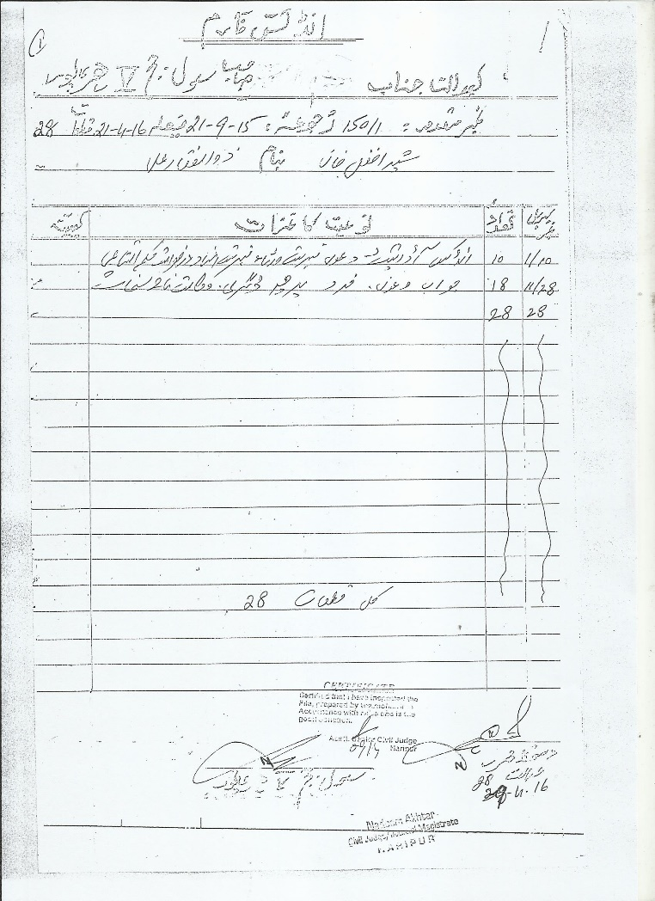

Slide 24
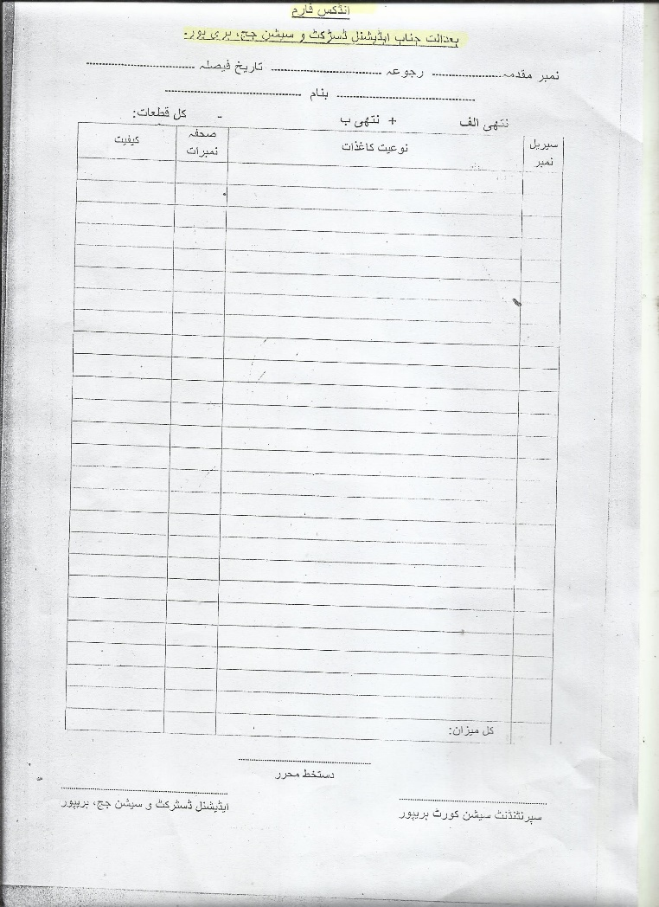

Slide 25
Consignment:
Examination of File by record keeper, entries of index.
Signing of Certificate, if file complete at the foot of index.
Entry in the appropriate register.
Entry in Dispatch/Challan register of the Court and return.
Dispatcher and Receiver of Judicial Files should be an authorized official
Transmission of file to another office/court, list to be prepared in duplicate upon requisition slip and signature of dispatcher to be obtained.
Duplicate list by the receiving official with signature.
Bundles.
Weeding, sorting out for destruction.

Slide 26
Preservation of Record, measures.
Sufficient equipment, Almirahs, steel shelves, wooden boards, cotton strap.
The Shelves/Record Room is to be kept free of rats, dirt, dust and direct sunlight.
Periodical spray with insecticide.
Computerization of consigned record.
-----------------------------------

Slide 27
Classification of Records
All Civil and Criminal records shall be arranged in separate Files, A, Ai, and B
Civil Record File A, shall contain
The index of Papers
The order sheets
Plaint together with schedule annexed and all document annexed
The written statement, Rejoinder etc
Application of parties strangers to the suit and court’s order thereon (Ai)
Reports of Record Departments (Ai)
Orders of arrest or attachment before judgment with all document (Ai)
Application for Review and court’s order (Ai)
Copies of Civil, Revenue and Municipal record received as evidence (Ai)
Issues
All Dispositions of witnesses
Documentary evidence
Commissions Reports
Applications for referral to Arbitration and the award along with all annexures
Deeds of withdrawal, compromise
The judgment or the Final order
The Decree
Judgment and Decree of Appellate Courts
All orders passed in Execution, with all objections, notices and reports of service thereon
All receipts of acknowledgement filed in execution
All notes in handwriting of the Judge
Appeals
The index of papers
The order sheets
The petition of Appeal
Copies of Judgments and decrees of lower courts
Cross objection
Issues referred for trial
Commissions
Any additional evidence
Withdrawal deeds and compromise
The judgment/final order
Any judgment and decree of a superior court
Power of attorney of counsel or agent of the parties

Slide 28
File B
All papers not included in File A and Ai, applications, process etc
-----------------------------------

Slide 29
Criminal Record
Part A Sessions Trial
The index
The order sheets
The charge
All Depositions of witnesses, statements
All documentary evidence
The final order/judgment
Notes of the Judge
Any order of High Court
Warrants returned after execution
All proceedings relating to realization of Fines
Power of attorney of counsel or agent of the parties
-----------------------------------

Slide 30
Part A Magisterial Trial and Inquiries
The index
The order sheet
Challan/complaint
All Depositions
All documentary evidence
Charge
Final order
Notes of the Magistrate
The judgment of the Appellate or Revisional Court
Fine Recovery Proceedings
Bonds u/s 110 Cr.PC
_____________________

Slide 31
In Appeal Cases
The index
Order sheets
Appeal petition
Copy of judgment of Lower Court
Additional evidence
The Notes
The Final order
Criminal Record
Part B
All papers not included in File A, applications, process etc
-----------------------------------

Slide 32
Classification of Records in terms of Preservation
KEEP FOREVER
All suits and appeals involving the tile to immovable property
Suits and appeals relating to the succession to an office, or to establish or set aside adoption
All suits and appeals relating to trusts or religious endowments
Records of attachment, sale and delivery of immovable property in execution of decrees, including all objections and orders thereon
Proceedings under the Succession Act, 1925
Proceedings under the Divorce Act (MFLO/FCA)
Correspondence record on matter connected with the administration of justice, annual reports. (However, may be destroyed after 3 years with the previous sanction of the District Judge)
-----------------------------------

Slide 33
Keep Preserved for 50 years
File A of
The cases relating to any of offences specified in Section 44 of Cr.PC (Provided if it is known that the offender concerned is dead then the record may be destroyed.
Untraced Criminal Cases punishable with death sentence
Adjourned cases against lunatics, unless have subsequently been tried or dead
-----------------------------------

Slide 34
Keep preserved for 20 years
Sessions cases if the sentence executed and warrant returned
The charge, finding and sentence in cases of conviction, to be relied upon for enhanced punishment in subsequent conviction
Cases against public servant, whatever may have been the result
-----------------------------------

Slide 35
Keep preserved for 12 years
Insolvency proceedings under chapter XX of the CPC
____________________

Slide 36
Keep preserved for 6 years
All civil suits and appeals (other than that to be preserved in perpetuity) if the decree has been executed or finally held incapable of execution
Cases tried under Section 30 Cr.PC, if sentence has been executed in case of conviction
Records relating to realization of fines
-----------------------------------

Slide 37
Keep preserved for 3 years
File A of
Criminal cases tried by Magistrates
Appeals against orders of Magistrates
All correspondence between the District Judge and subordinate Courts
Other records, periodical statements, reports, proceedings, application, not expressly provided for in these rules. However, may be retained by special orders
-----------------------------------

Slide 38
Keep for 1 year
File B of all civil and criminal cases and appeals
Proceedings of other courts, forwarding notices, proclamation, calling for records etc.
-----------------------------------

Slide 39
How to calculate the period
Be taken to run from the date of the final orders of the court of first instance, or in the event of an appeal from that of decision of the appeal
-----------------------------------

Slide 40
DESTRUCTION OF JUDICIAL RECORD
Vol-IV Ch:16 Part-F
Rules Framed, by the chief Court, confirmed by the Government and sanctioned by the Governor General of India, Under Powers conferred by Section 5 of the Destruction of Records Act, 1879, Repealed by Destruction of Record Act, 1917, whereafter under Section 3 of the Act Lahore High Court made Rules for destruction of records.
-----------------------------------

Slide 41
Procedure of Destruction
Obsolete records and Registers to be destroyed in September every year
Before destruction of File A record of all private document belonging to private persons or to Government, parties to proceedings, shall be preserved and tied up in a separate parcel and notices, as far as practicable, be given to the persons, who produced them, requiring them to take back within six months from the date of notice. They are also warned about the consequences
All court fee stamps be cancelled before destruction
Destruction by tearing and soaking in water
Destroyed papers be sold out/forwarded to the nearest Jail Superintendent
Sale proceeds, if any, be deposited in the treasury and accounts be maintained
A note of every record destroyed shall be made on the register in which the case is registered, under signature of a responsible officer
Record of destruction to be maintained by record keeper
-----------------------------------

Slide 42
Destruction of Registers
From the date of last entry
Registers to be destroyed after 12 years
Civil Registers No. X and XIV
Execution of decrees
Miscellaneous Appeals
Criminal Register No. I, III, IV and XVII
Complaint, cognizable or non-cognizable cases
SP and Local Laws
Miscellaneous
Summary trials
-----------------------------------

Slide 43
Registers to be destroyed after 6 years
Civil Registers No. XVI, XVII, XIX, XXII
Register of JDs imprisoned
Register of stamp deficiencies
Commissions
Register of warrants executed by Bailiffs
Criminal Register No. XVI and XVII
General Register of decided cases (Record keeper)
Register of diet money
Civil and Criminal Register C and D
Miscellaneous Proceedings
Dispatch Register
-----------------------------------

Slide 44
Registers to be destroyed after 3 years
Civil Registers No.VII, VIII, IX, XII, XVII, XXIII, XXIV, XXV
Pauper applications
Rejected and returned plaints
Register of Dates
Review
Stamp Deficiencies
Contempt of Court
Served Process by Process Server
Returned Documents
Deposit and Refund of commissions in Executions
Criminal Registers No.V, VI, XIII, XIV, XV and XIX
Register of decided cases
Annual Returns (not maintained)
Persons admitted to and removed from court lock-ups
Register of Judicial Fines
Register of Realized Fines
Released Prisoners, Punishment reduced
Civil and Criminal Registers. E, F, G, H
Register of General orders issued by High Court
Register Property in Nazir’s Store Room
Register of Ministerial Staff
Register of Petition writers
-----------------------------------

Slide 45

No other Judicial Register to be destroyed.
-----------------------------------

Slide 46
Summary
The ultimate test of a good record maintenance program is whether the records are available to those who need them, when and where they are needed (Effectiveness), the manner in which they are made available (Efficiency), and at what cost (Economy).
-------------------------

